Slide 1
Chapter 9
Professional Ethics

Slide 2
Chapter Overview
Introduction
How well developed are the computing professions?
Software engineering code of ethics
Analysis of the code
Case studies
Whistle-blowing
1-<number>

Slide 3
9.1 Introduction
Informally, profession a vocation requiring…
  High level of education
  Practical experience
We pay professionals well
  Doctors
  Lawyers
We trust professionals to…
  Correctly ascertain and treat problems
  Take actions for the good of their clients
1-<number>

Slide 4
9.2 How Well Developed Are the Computing Professions?
1-<number>

Slide 5
Characteristics of a Profession
Initial professional education
Accreditation
Skills development
Certification
Licensing
Professional development
Code of ethics
Professional society
1-<number>

Slide 6
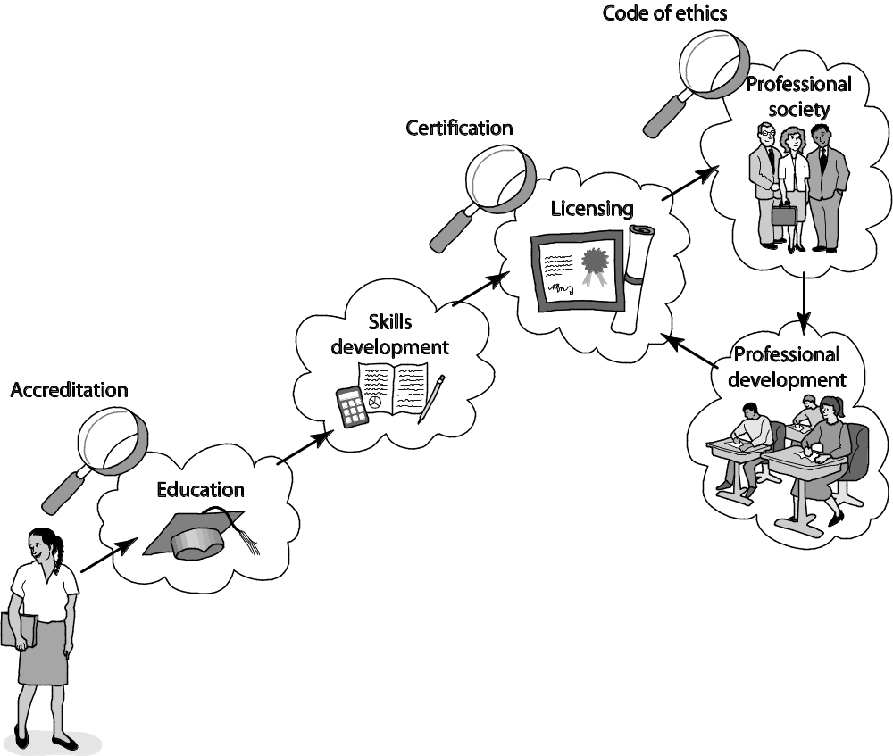
Attributes of a Mature Profession
1-<number>

Slide 7
Certified Public Accountants
Bachelor’s degree
  150+ semester hours
  24+ hours of accounting-related classes
Two years’ experience working under supervision of a CPA
CPA exam
To retain certification
  Continuing education
  Follow code of ethics
1-<number>

Slide 8
Computer-Related Careers
Certification and licensing not required
College degree not required
Apprenticeship not required
Membership in professional society optional
No specific requirements for continuing education
Most computer programmers, system analysts, etc. are part of teams
1-<number>

Slide 9
Status of Certification and Licensing
Two largest organizations supporting computing field
  Association for Computing Machinery (ACM)
  IEEE Computer Society (IEEE-CS)
Software engineer: someone engaged in development or maintenance of software, or teaches in this area
ACM opposed to licensing of software engineers at this time
  Move thought to be premature
  Wouldn’t be effective at improving quality and reliability of software
1-<number>

Slide 10
Ability to Harm Public
Many computer professionals hold responsibilities similar to those held by members of mature professions
Therac-25 killed or gravely injured at least six people
Millions rely upon software rather than accountants to prepare their tax returns
Millions of people rely on system administrators to keep their work-related information secure
1-<number>

Slide 11
The Importance of Taking Personal Responsibility
The ability to cause harm to members of the public is a powerful reason why those in computer-related careers must act according to ethical principles. Without formal certification and licensing and other components of a well-developed profession to rely upon, those in computer-related careers must take more personal responsibility for developing their ethical decision-making skills.
1-<number>

Slide 12
9.3 Software Engineering Code of Ethics
1-<number>

Slide 13
Preamble of Code
Software engineers have opportunities to do good or do harm
Software engineers ought to be committed to doing good
Eight principles identify key ethical relationships and obligations within these relationship
Code should be seen as a whole, not a collection of parts
Concern for the public interest is paramount
1-<number>

Slide 14
Eight Principles Identify Morally Responsible Relationships
Public
Client and employer
Product
Judgment
Management
Profession
Colleagues
Self
1-<number>

Slide 15
Act Consistently with Public Interest
1.01 “Accept full responsibility for own work”
1.02 Balance competing interests
1.03 Approve software only if it is safe
1.04 Disclose actual/potential dangers
1.05 “Cooperate in efforts to address” public concerns
1.06 “Be fair and avoid deception in all statements”
1.07 Consider factors that diminish access to software
1.08 “Volunteer professional skills to good causes”
1-<number>

Slide 16

Clause 1.03
Approve Software Only If It Is Safe
1-<number>

Slide 17
Act in Best Interest of Client, Employer
2.01 Act within areas of competence
2.02 Don’t use software obtained illegally
2.03 Only use property in authorized ways
2.04 Ensure documents are approved
2.05 Respect confidentiality
2.06 Promptly report problems with project
2.07 Report issues of social concern
2.08 Refuse outside work detrimental to job
2.09 Put employer’s/client’s interests first, unless overriding moral concern
1-<number>

